Slide 1
Object Oriented Programming Lecture -
Prof. Varsha Dange

Slide 2
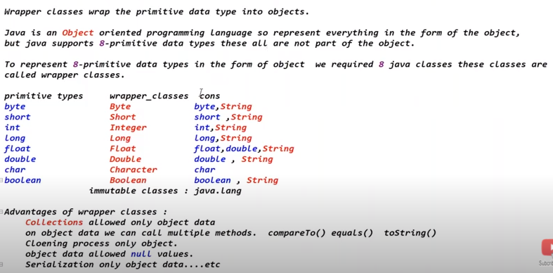
Wrapper classes

Slide 3
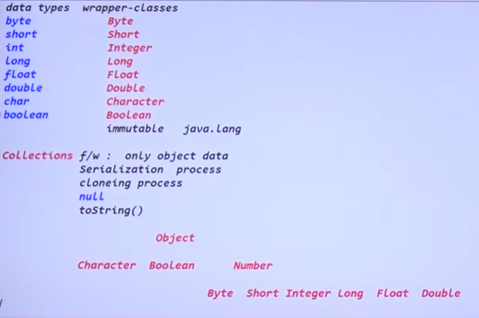
Wrapper classes

Slide 4
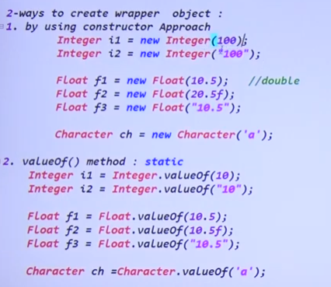
Wrapper classes

Slide 5
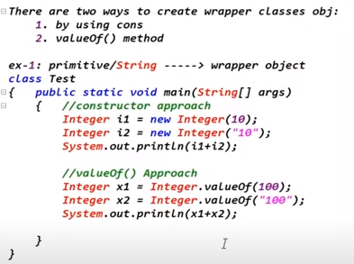
Wrapper classes

Slide 6

Wrapper classes

Slide 7
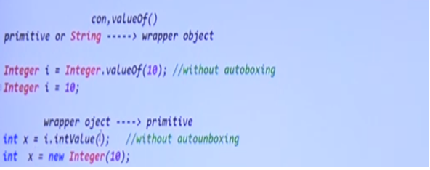
Autoboxing and unboxing
Automatic conversion primitive data type or string to wrapper object----is auto boxing

Slide 8
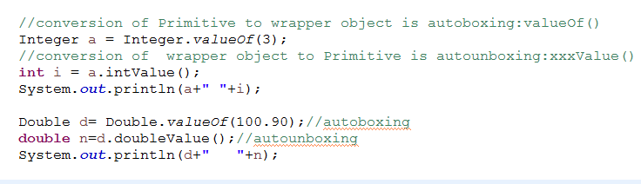
Autoboxing and Autounboxing

Slide 9
